Slide 1
Seminar Hochwasser SS 2021
Thematische Vertiefung Georisiken –Analyse und Management
Hochwasserrisiko – Wiederholung und Modellanwendung
16.07.2021
Bruno Merz^{1,2}, Luzie Wietzke¹
¹GFZ German Research Centre for Geosciences
Telegrafenberg, Potsdam
²Institute for Earth and Environmental Sciences
Professor for Engineering Hydrology and Management of Georisks
bmerz@gfz-potsdam.de
lwietzke@gfz-potsdam.de
Notes:
Ziel der VL: Einen kurzen Überblick zu den Basics der Extremwertstatistik und –theorie.
EVS spielt wichtige Rolle in der Risikoanalyse als zentraler Bestandteil der Gefahrenbewertung (Gefahr, Vulnerabilität, Exposition). EVS macht es möglich, gemessene Daten zu extrapolieren in einen bisher unbekannten, extremen Bereich durch die Verwendung statistischer Modelle.

Slide 2
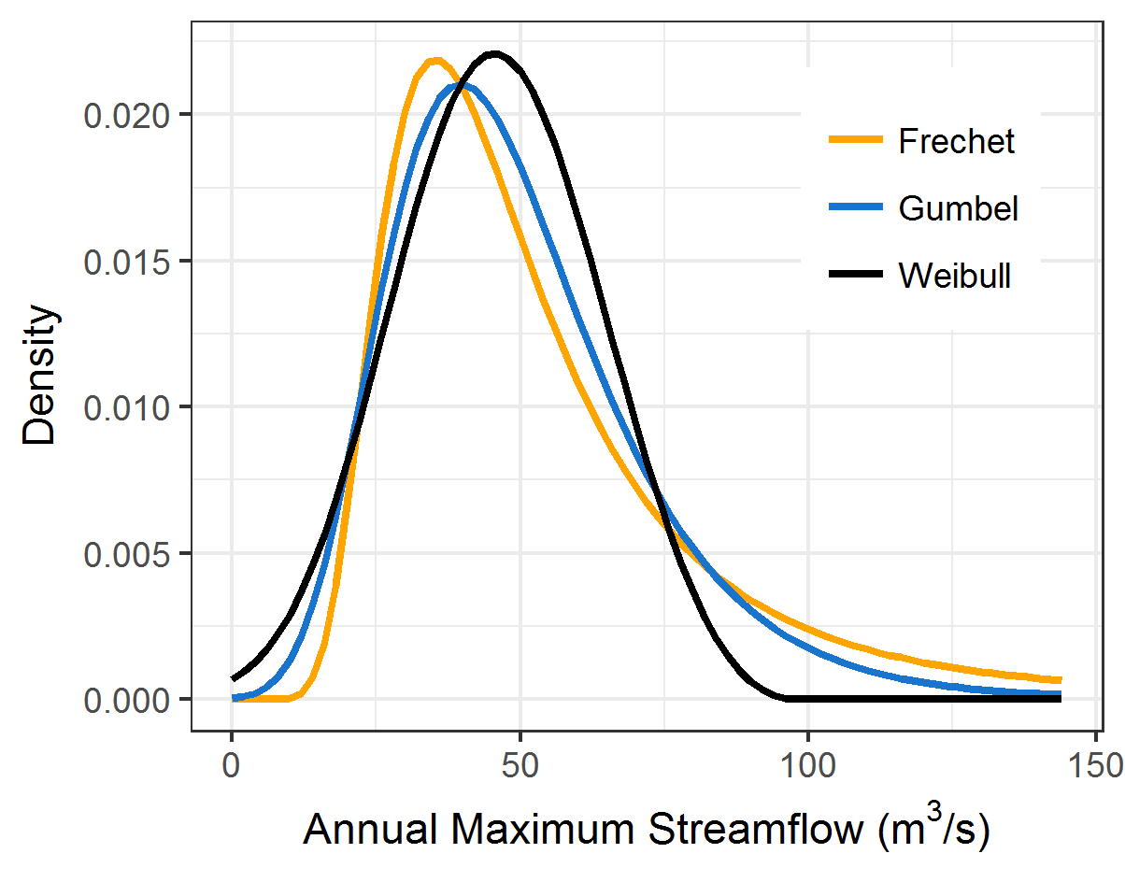
Zusammenfassung - Hochwasserstatistikübungen
Zentrales Ziel der Extremwertstatistik: Extrapolation in den unbekannten, extremen Bereich durch Abschätzung der zugrundeliegenden Verteilung
EVS ist von großer Bedeutung für Gefahrenbewertung und wichtiger Bestandteil der Risikoanalyse
PDF
2 Hauptansätze zur Ableitung von Extremverteilungen:
Block maxima-Methode (Verteilungsfamilie: GEV)
Peak over threshold-Methode (Verteilungsfamilie: GPD)
GEV ist eine 3-parametrische Verteilung, deren Shape parameter das Tail-Verhalten wesentlich beeinflusst
In Schätzung der Verteilungsfunktion & der dazugehörigen Parameter gibt es viele Unsicherheiten
17
“Heavy tail”: Höhere Wahrscheinlichkeit der Extremwerte
Notes:
Quantile-Quantile (Q-Q) plots are a popular technique for checking the fit of extremal distributions, as they are particularly effective at highlighting apparent discrepancies in the extreme upper tail.

Slide 3
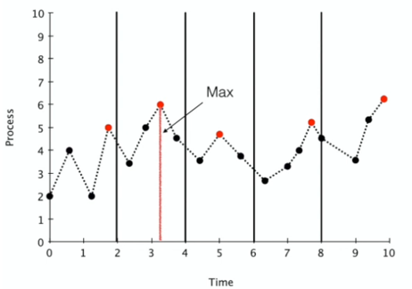
Extremwertstatistik - Hochwasserhäufigkeitsverteilung
Blockmaxima
(usually annually)
Generalisierte Extrem-
wertverteilung (GEV)
Fit an
extreme value distribution
6
Create flood time series : Block Maxima oder Peak-Over-Threshold
Choose distribution function: GEV
Fit distribution function to sample: e.g. L-moments
Note: Assumptions, uncertainties
“Flood Frequency Analysis”
Notes:
Wie kommen wir jetzt auf unsere Extremwertverteilung? Hier gibt es zwei Ansätze:
Block Maxima Method or Peak-Over-Threshold Method.
Traditionell wird die BM methode verwandt, häufig auf Grundlage von jährlichen Blöcken.

Slide 4
Definition: Gefährdung – Vulnerabilität – Risiko
Danger
(potentially dangerous process)
elements of risk
(people, goods,
Environment...)
risk analysis :
What can happen? Risk analysis, scenario building
How probable is it? Statistical/probabilistic analysis
What are the consequences? Exposure, vulnerability analysis
Risiko:
: all relevant damage scenarios
: probability of the scenarios
: damage for scenario i
: number of scenarios
described by:
intensity
probability
described by:
exposure
susceptibility
Gefährdung
Vulnerabilität
Risiko

Slide 5
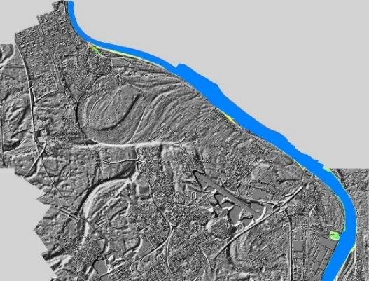

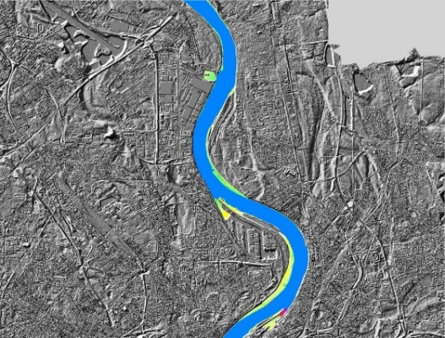
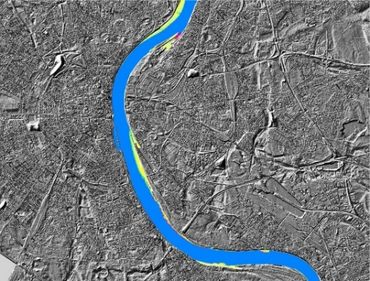
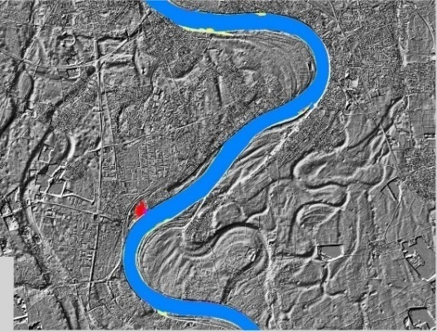
Flood risk for cities near rivers (simple approach)
System und Daten
Risk analysis for Cologne/Rhine
FFA based on long-term observations
Transfer of water levels to flood plains
damage assessment
15.00
12.00
9.00
Water level gauge Cologne/Rhine [m]
6.00
3.00
0.00
1320
1370
1420
1470
1520
1570
1620
1670
1720
1770
1820
1870
1920
1970

Slide 6
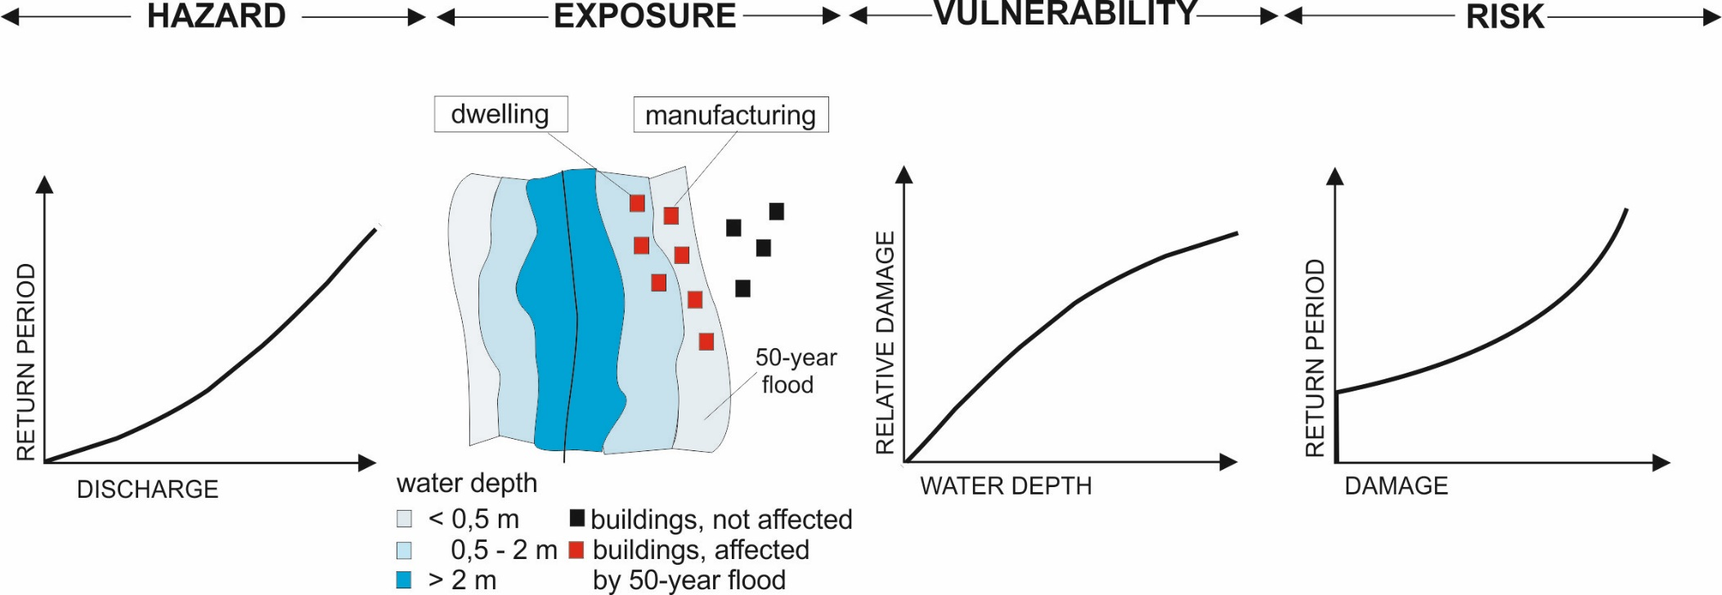
Flood risk for cities near rivers (simple approach)
What can happen? Risk analysis, scenario creation (for different water levels)
How probable is it? Statistical/probabilistic analysis
What are the consequences? Exposure, vulnerability analysis
Notes:
What can go wrong? Scenarios with different flood water levels at gauge
How likely is it that it will happen? Probabilities of each flood water level occurring
If it does happen, what are the consequences? Damage of each flood water level

Slide 7
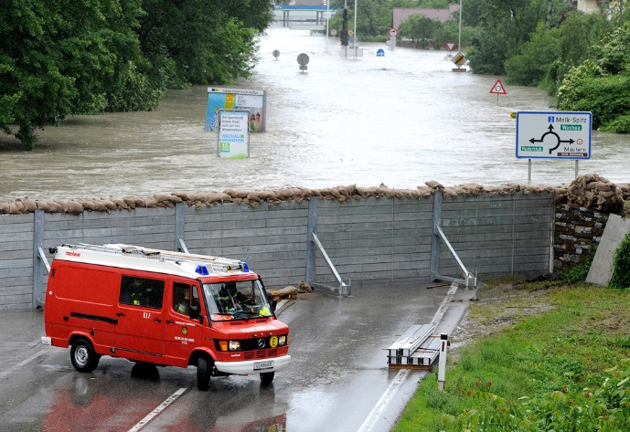
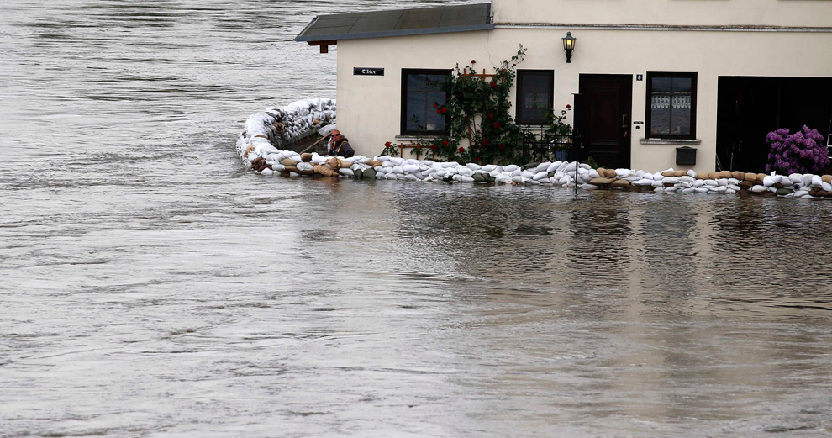

Changes in risk over time
factors are
climate change (hazard)
Landnutzungsänderungen (exposure)
land use changes (Asset changes) due to population and economic growth (exposure)
Degrading defense systems (e.g. dikes) (hazard)
Improvement of structural protective measures(hazard)
Change in private precautionary measures(vulnerability)
… all other important time-varying variables
flood protection wall
Private precautionary measures - sandbags

Slide 8
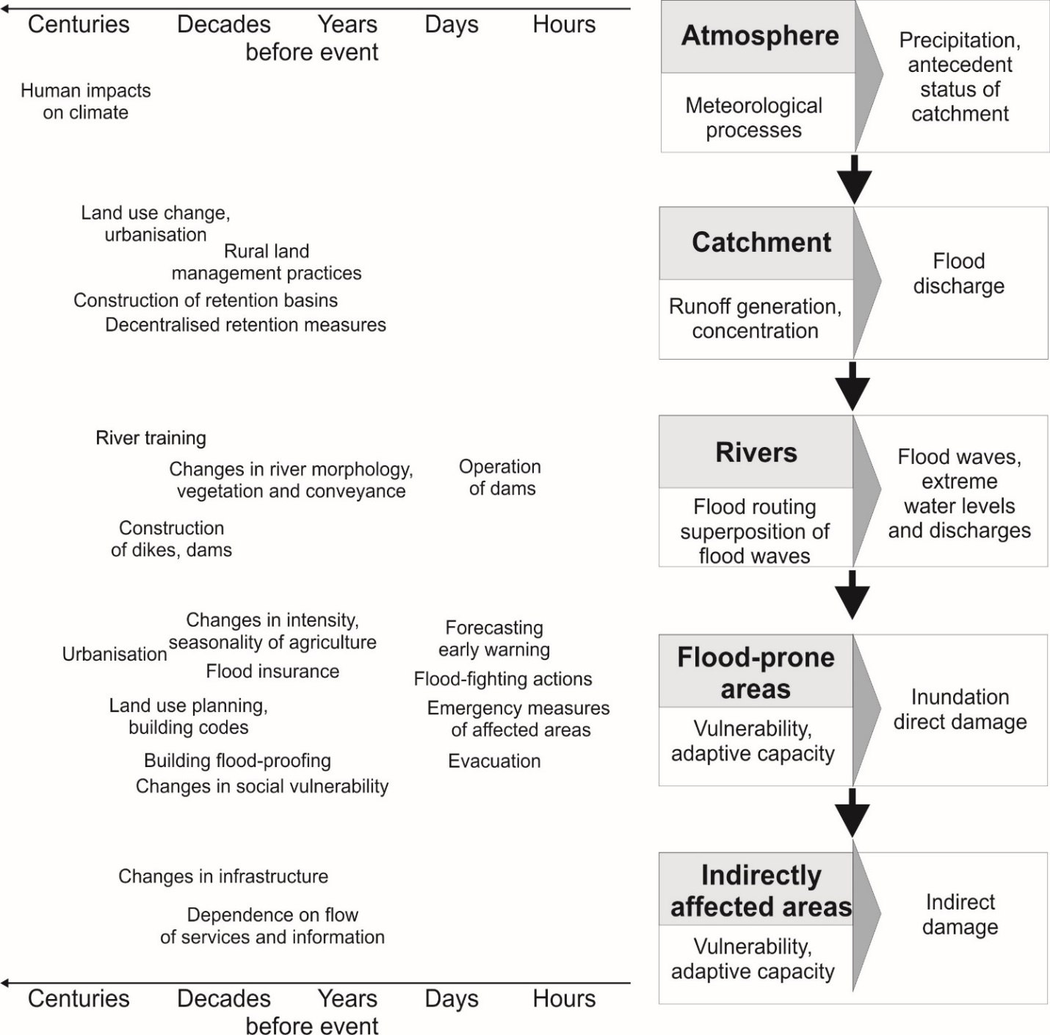
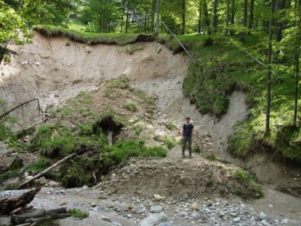
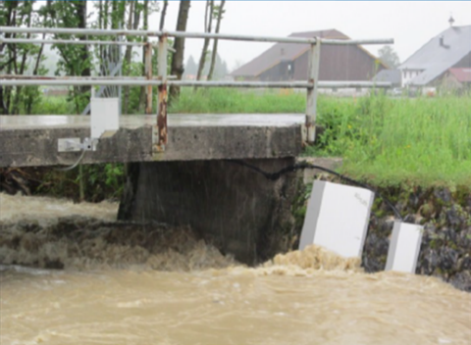
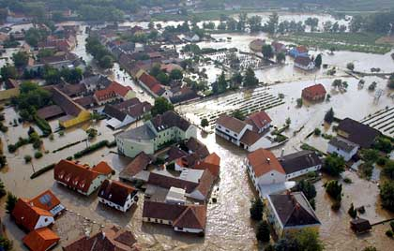
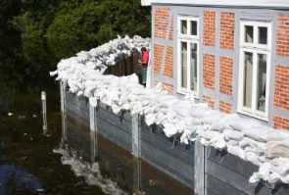
Flood risk & human impacts (Merz et al., 2010, NHESS)

Slide 9
Hochwasserrisikobewertung - Flood risk assessment
All risk components should be included (hazard, exposure and vulnerability).
All processes from atmosphere, catchment area and river system to damage mechanisms should be included
A complete model chain for flood risk assessment could look like this:
Input
Output
Meteorological fields
(e.g. precipitation, temperature)
Hydrological model
(catchment processes)
Discharge time series (Q)
Hazard
Discharge time series
Hydrodynamic model
(river system processes)
Inundation depth and duration (m)
Inundation depth and duration
Damage model
(damage mechanism)
Spatial patterns of damage along the river (e.g. economic loss(€))
Exposure
Vulnerability

Slide 10
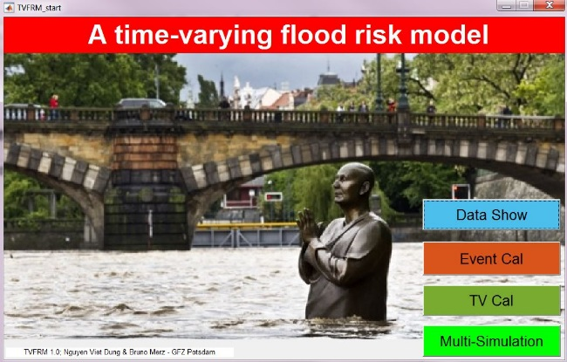
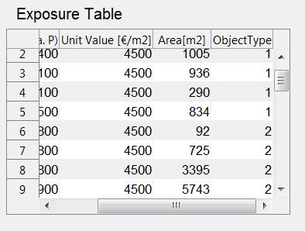
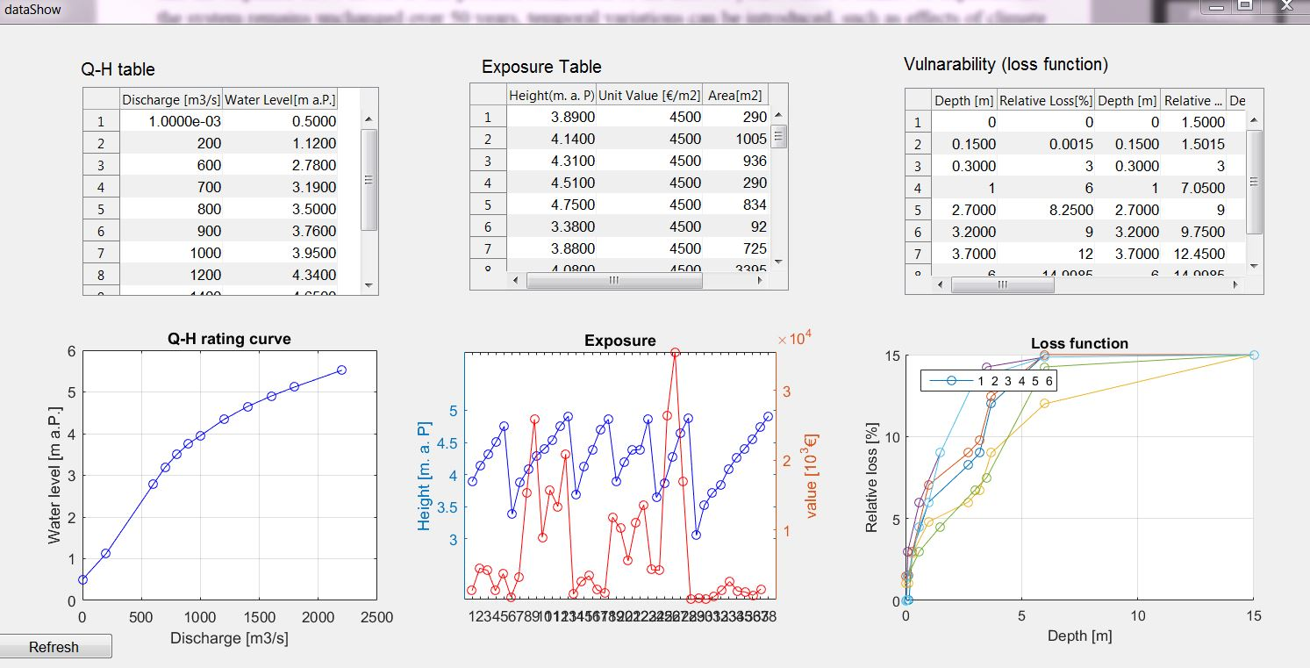
Simple time-varying flood-risk model
Simple but complete risk analysis
(so far only for the city of Leipheim)
3 Module:
Single event calculation
Time-varying calculation (sensitivity analysis)
Multiple simulation (sensitivity analysis)
Required input data are
Discharge (Q) vs water level (H) rating curve
Exposure table in Abhängikeit von H, unit asset value, area of building footprint, building type
Vulnerability (loss function) based on inundation depth and relative loss
1=Residential, single storey without basement
2=Residential, single storey with basement
3=Residential, multi-storey without basement
4=Commercial, single storey
5=Commercial, multi-storey
6=Other buildings
Notes:
Exposure Grafik: Höhe gegen Einzelobjekte aufgetragen. 5x Typ 1, 8x Typ 2etc., Typen 1, 3 & 6 sind „am wenigsten“ Wert

Slide 11
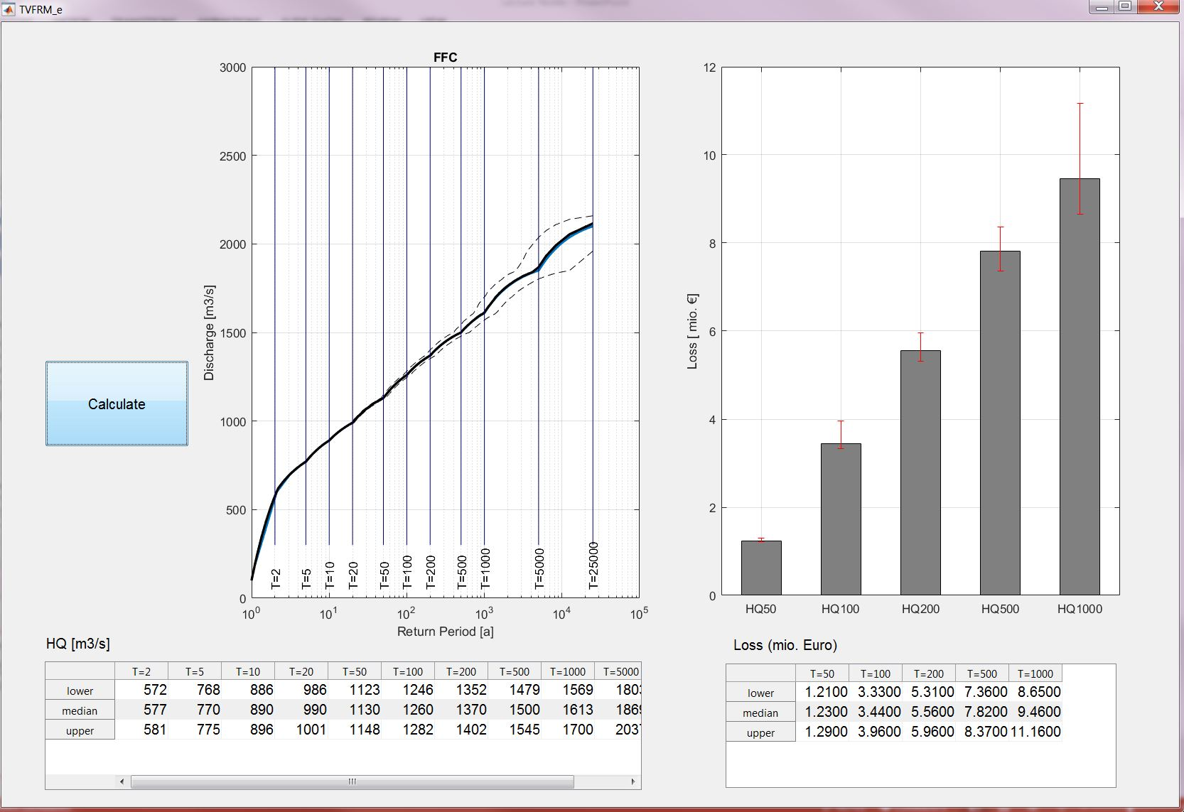
1) Single event calculation
Flood frequency curve (FFC) for linking flood magnitudes and return intervals (return periods) → Estimation of the flood magnitude
Fitting of theoretical distribution functions to observational data
Using this empirical FFC, the model calculates the losses for each return interval, taking into account the exposure table and the damage function

Slide 12
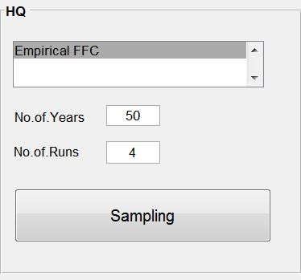
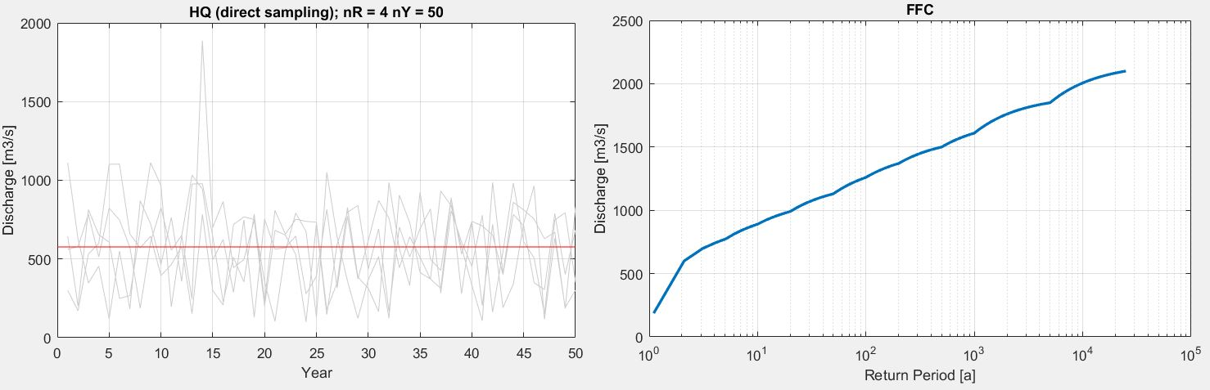
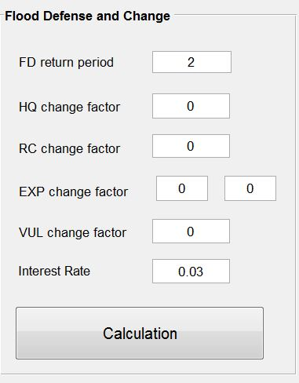
2) Time-varying (TV) calculation (Sensitivitätsanalyse)
Objective: Understand the impact of changes in the risk components
n-times random sampling of events (e.g. 50 years) from the existing time series → generation of FFC
Flood protection level is determined (e.g. 2 years, 100 years)
Time-varying components:
Discharge value in defined period (HQ)
Rating curve (relationship between Q and H)
Exposure
: building value (1st box) and building area (2nd box)
Vulnerability
Interest rate (due to inflation)
Notes:
We sample 4 times of a time series with length of 50 years.
Change in HQ: due to change in channel geometry for instance

Slide 13
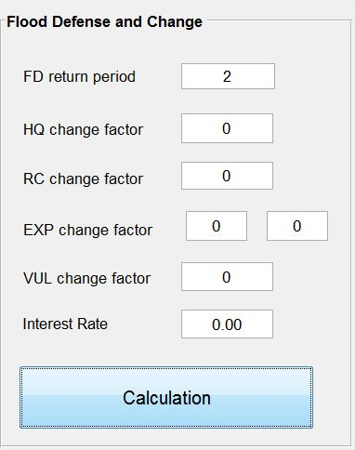
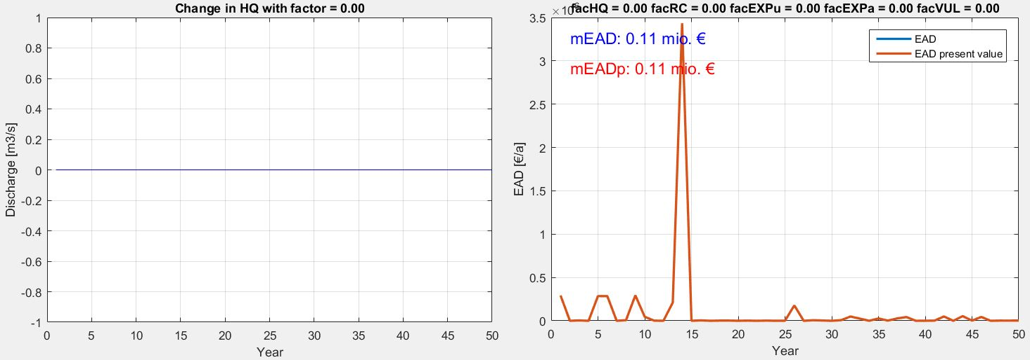
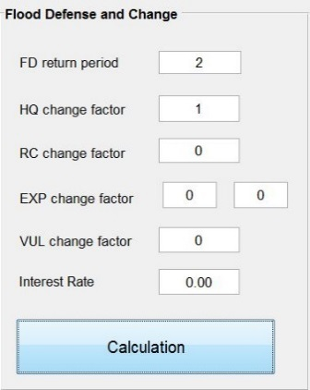
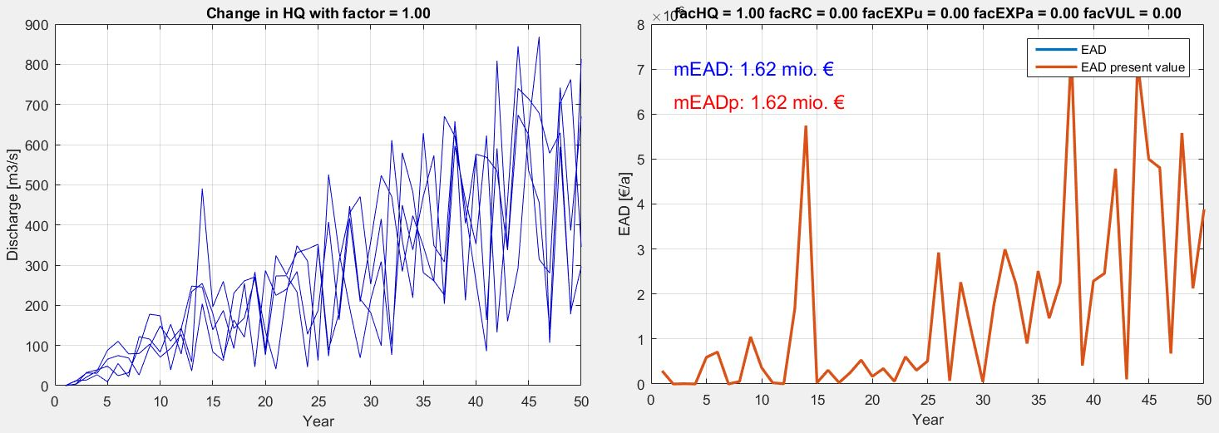
2) Time-varying (TV) calculation (Sensitivitätsanalyse)
Example: change in only discharge
Results are shown as expected annual damage (EAD)
EAD is the average of flood damages calculated over a number of events.

Slide 14
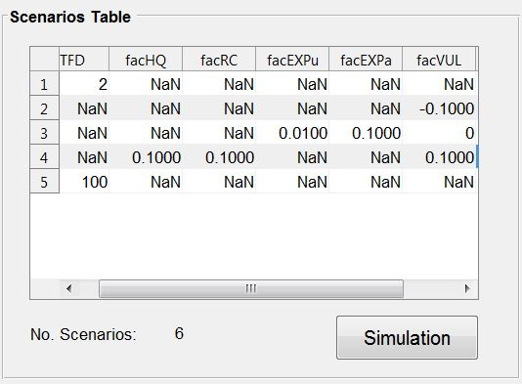
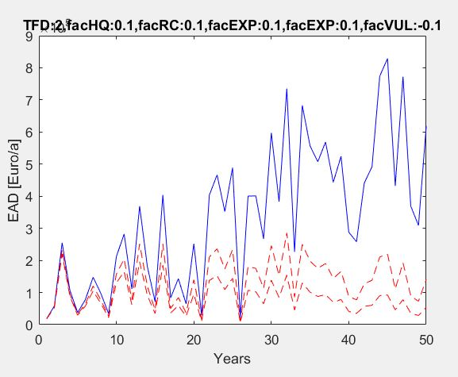
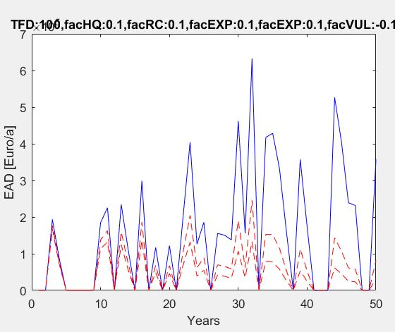
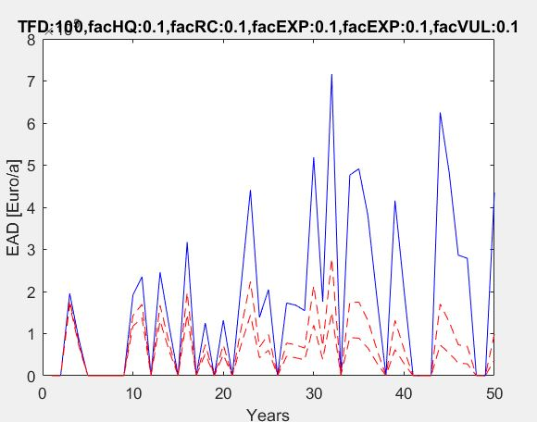
3) Multiple Simulation (Sensitivity Analysis)
HQ is sampled for defined number of years and runs.
Multiple simulation enables us to simulate different scenarios at the same time.
NaN means no new scenario value for that component
Increase in defense design level
Increase in vulnerability

Slide 15
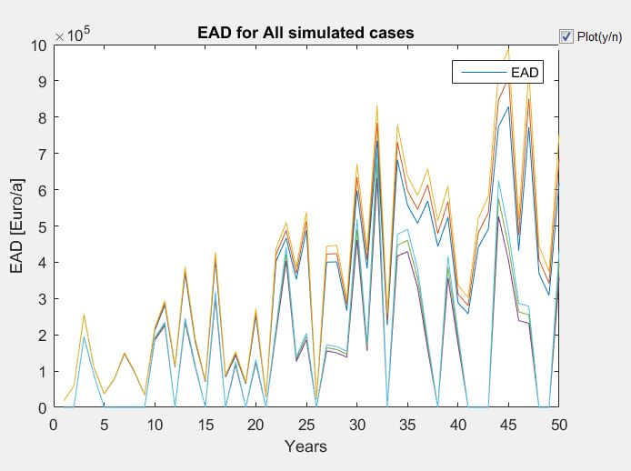
3) Multiple Simulation (Sensitivity Analysis)
It is possible to show EADs for all scenarios
In this example
defense design level = {2, 100} years
change in HQ= {0.1}
change in RC= {0.1}
change in Exposure (Value)= {0.1}
change in Exposure (Area)= {0.1}
change in Vulnerability= {-0.1, 0, 0.1}
EAD varies between € 0 and 1 million over 50 years.

Slide 16
Übung: Sensitivitätsanalyse
(We randomly sample flood events from an existing time series. In scenario A for 50 years and in scenario B for 200 years, in both scenarios the flood protection measures are designed for a 100-year event. In which scenario do we expect greater damage and why?)
(In Scenario B (200 years) we now assume a flood protection level of 2 years. What change in damage can be expected?)
(What is the impact of changes in)
Hazard components (design year of flood defense, rating curve),
Exposure components (asset values, building areas, inflation rate), und
Vulnerability
on the expected damage?

Slide 17
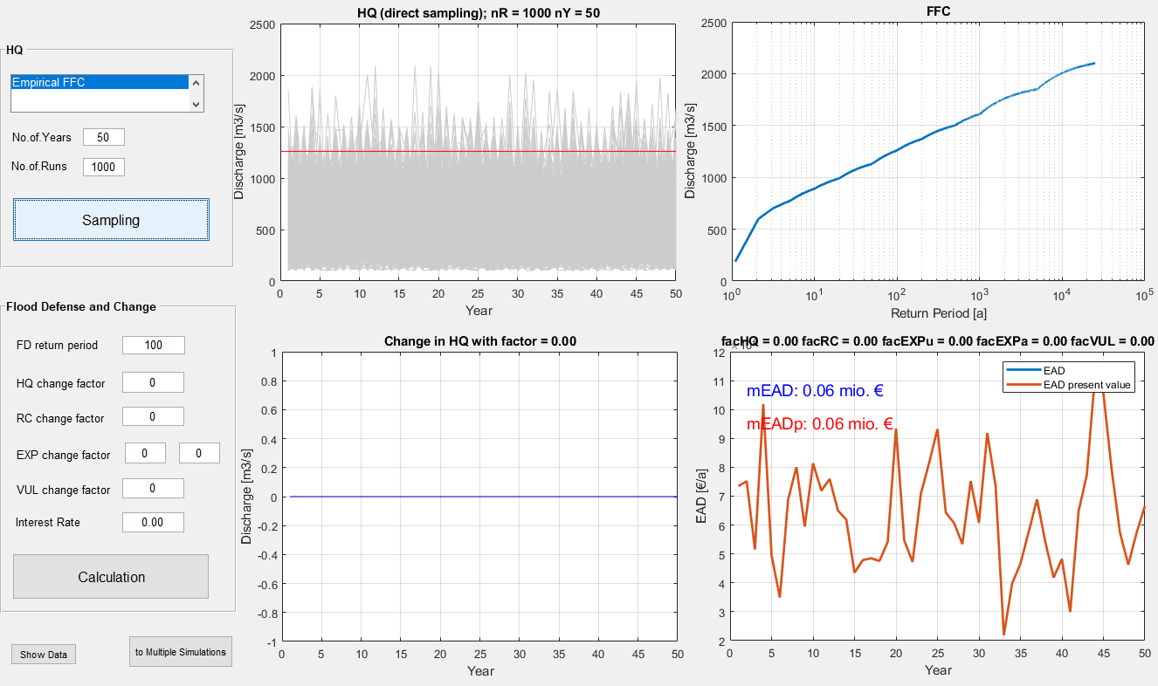
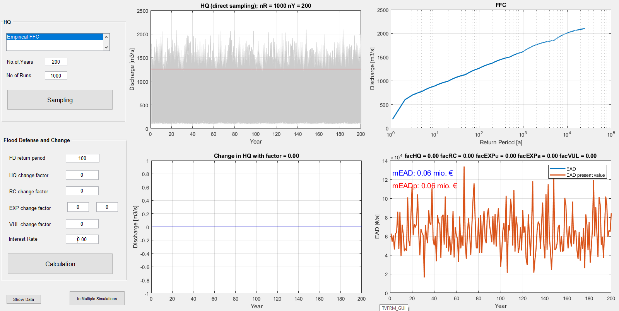
We randomly sample flood events from an existing time series. In scenario A for 50 years and in scenario B for 200 years, in both scenarios the flood protection measures are designed for a 100-year event. In which scenario do we expect greater damage and why?

Slide 18
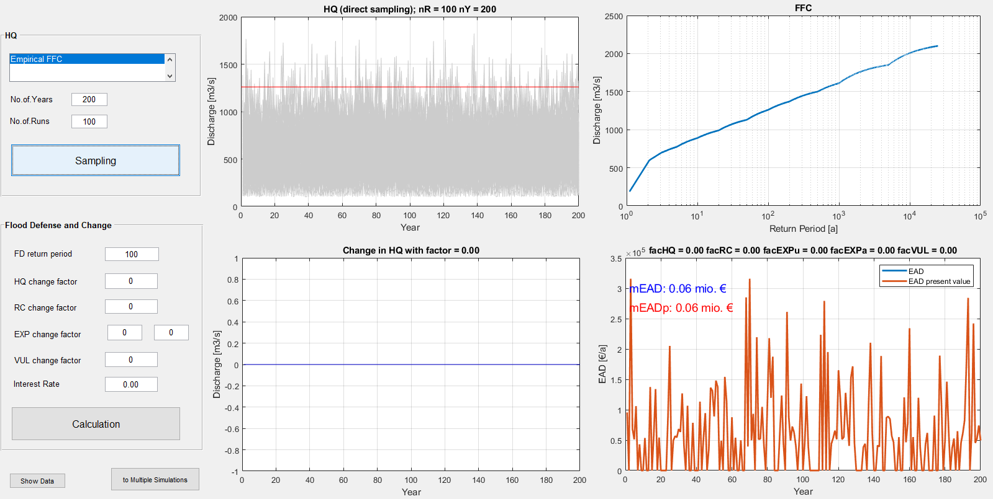
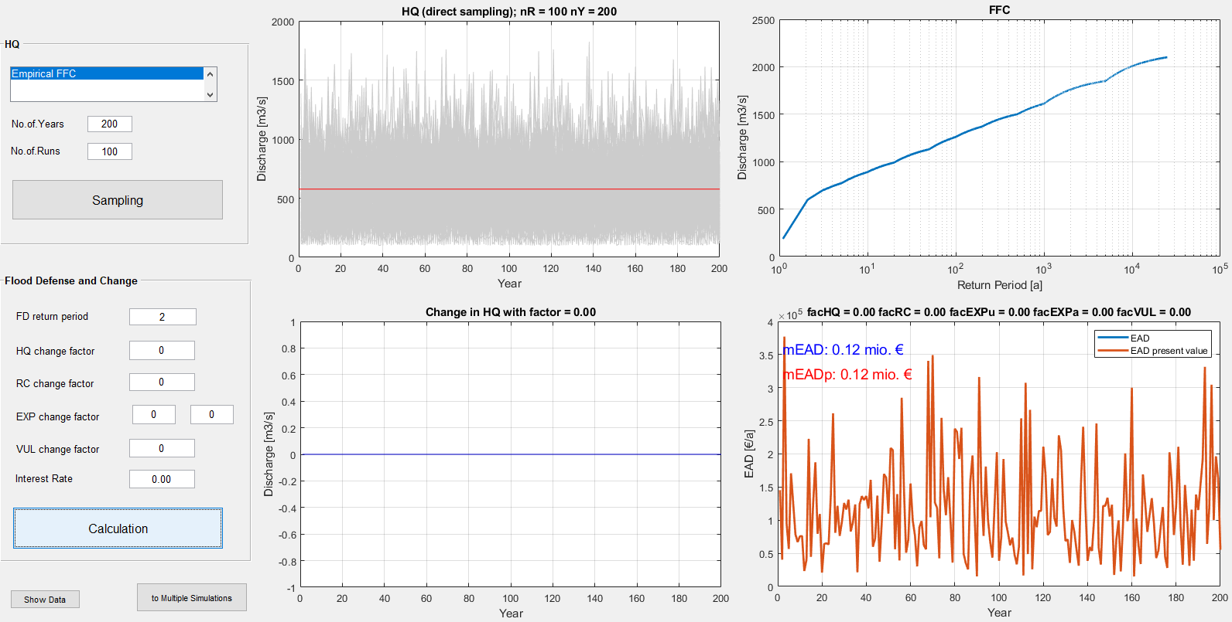
2) In Scenario B (200 years) we now assume a flood protection level of 2 years. What change in damage can be expected?

Slide 19
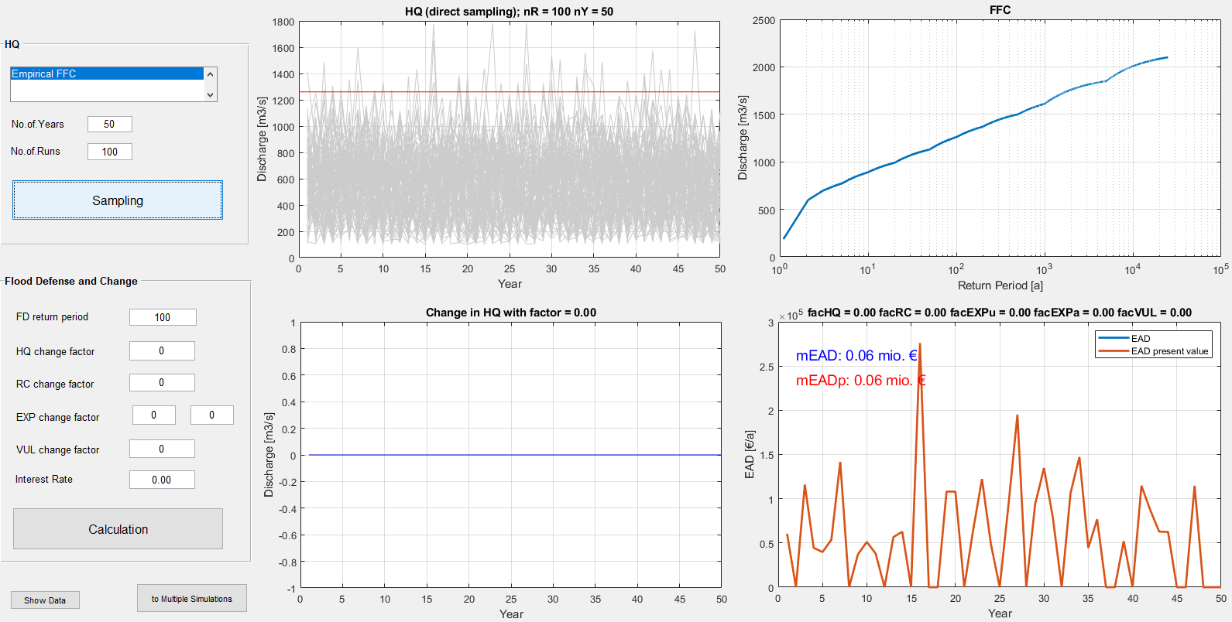
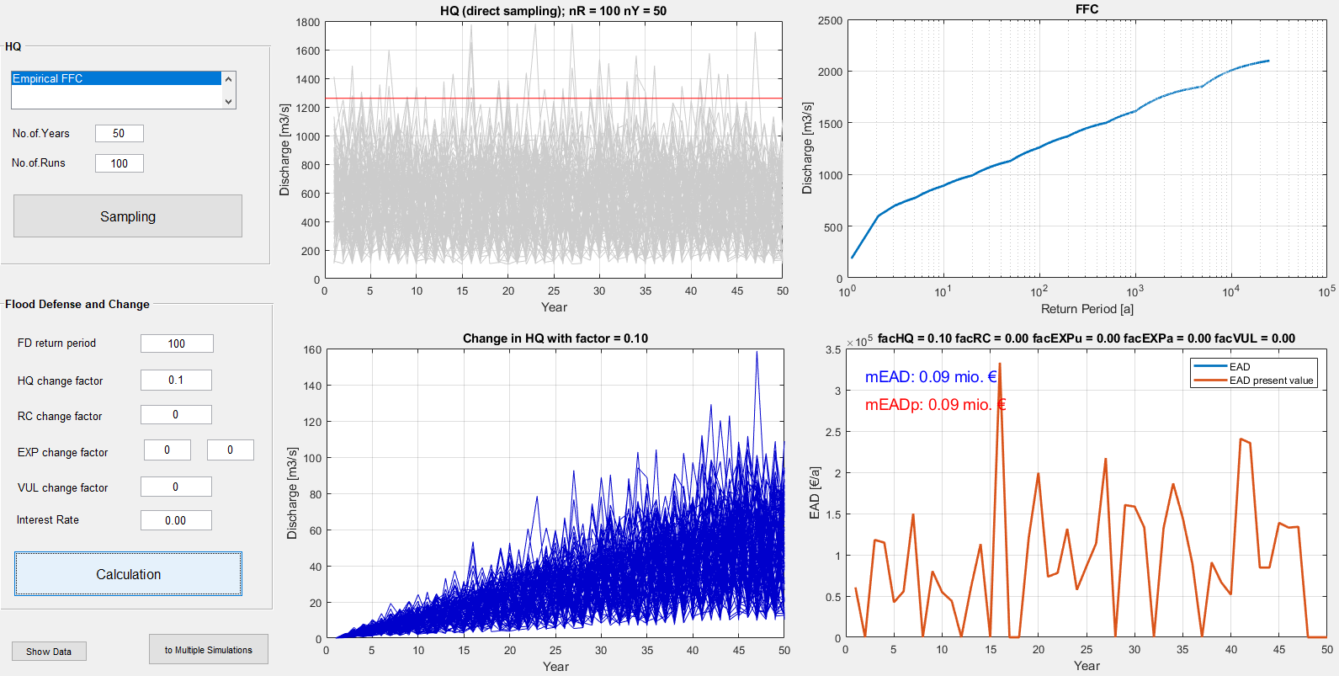
What is the impact of changes in
Hazard components (design year of flood defense, rating curve),
On the expected damage?

Slide 20
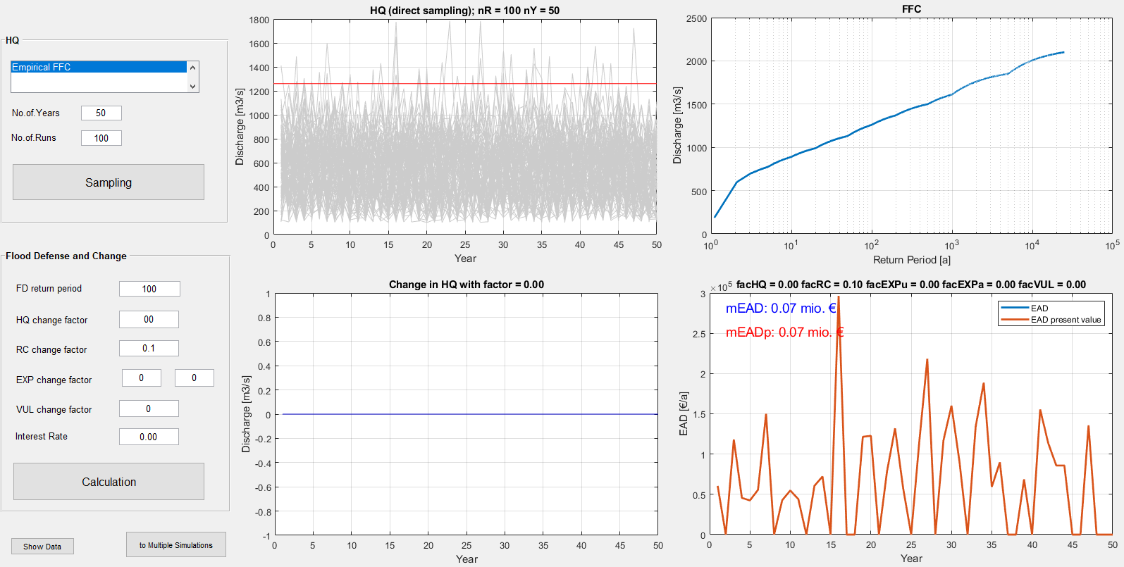
3) How big is the impact of changes in
Hazard components (design year of flood defense, rating curve),
On the expected damage?

Slide 21
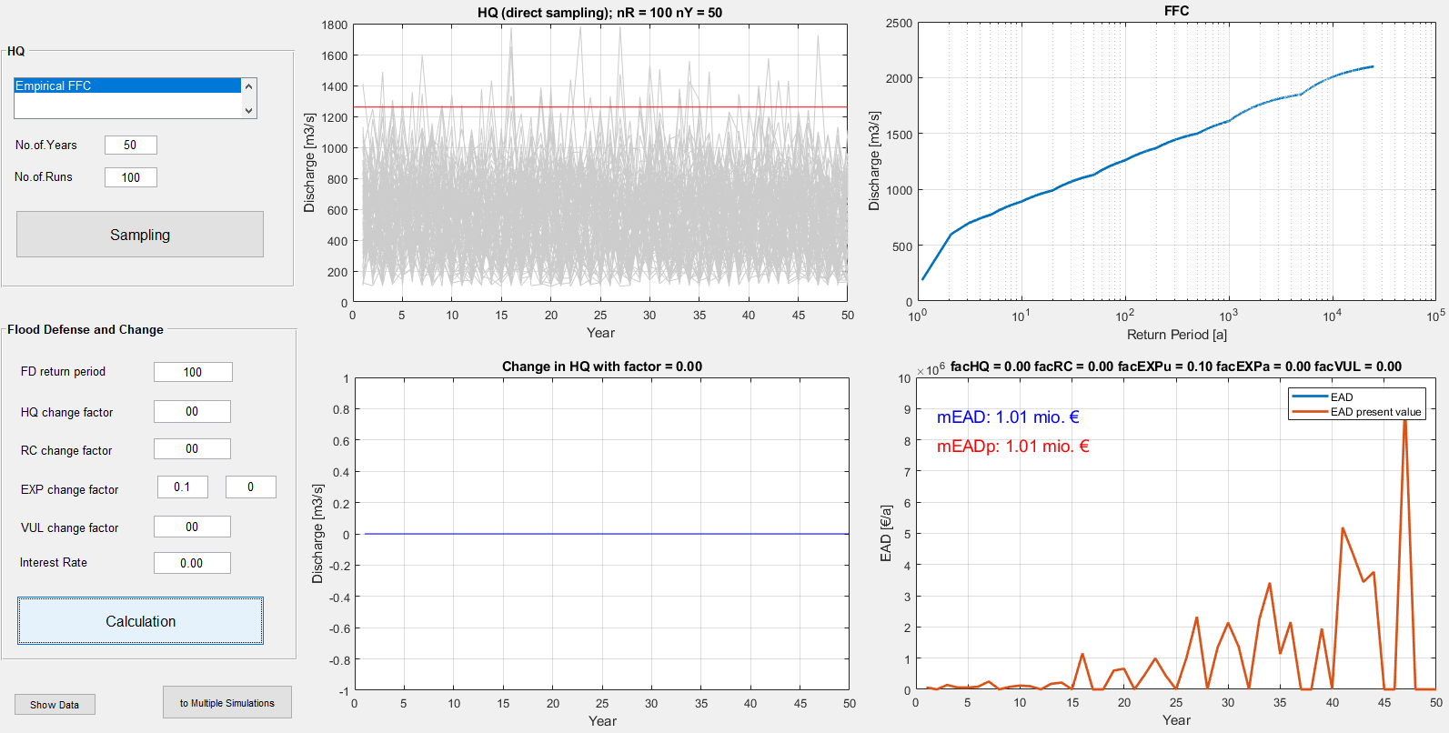
3) How big is the impact of changes in
Exposure components (asset values, building areas, inflation rate), on the expected damage?

Slide 22
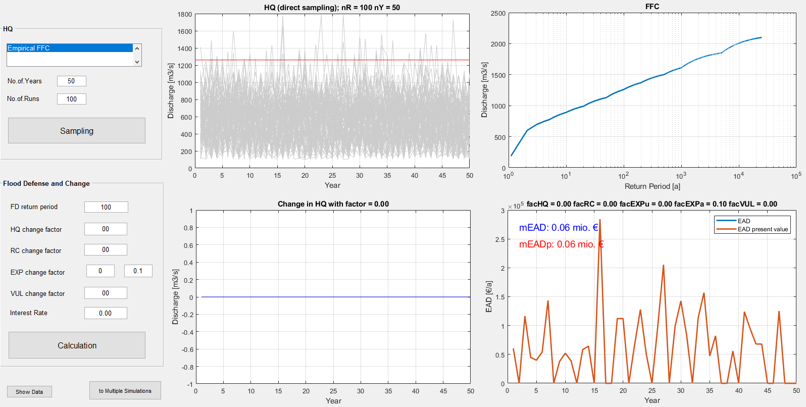
3) How big is the impact of changes in
Exposure components (asset values, building areas, inflation rate), on the expected damage?

Slide 23
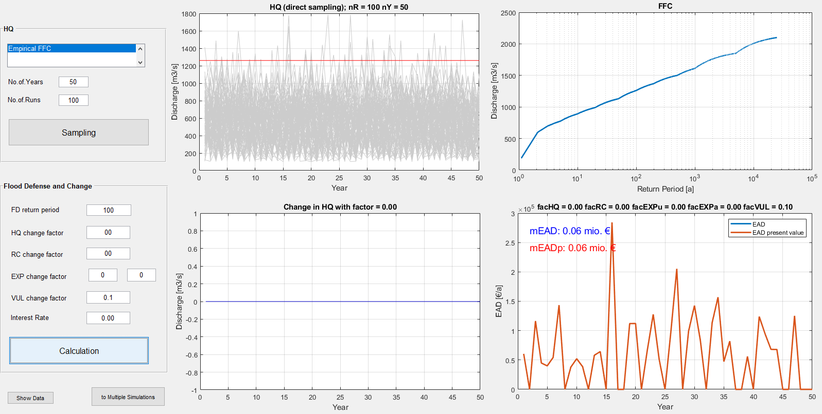
3) How big is the impact of changes in
Vulnerability to the expected damage?

